Slide 1
From Progress to Progress +
Training & Assessment

Slide 2
Progress: 2018
To ensure the curriculum equips doctors with generic skills
‘High level’ outcomes based curriculum
Based on generic professional capabilities
Move away from tick box, time based training
Capability based training
Subspecialty curricula aligned to Progress
Preparation for greater flexibility
Better aligned to future ways of working
Notes:
The introduction of Progress in 2018 was a major curricular change, moving away from a rigid, tick box approach to an outcome based curriculum based on generic professional capabilities. This has paved the way for greater flexibility and to train paediatricians who will be better able to work across a wide range of settings. As a ‘high level’ curriculum it has less granular detail and therefore depends on good supervision to support trainees.

Slide 3
Moving to Progress+: 2023
Structural Change
Reduction in the overall indicative length of training from eight to seven years
Change to two training levels; Core Paediatrics (Year 1-4) and Specialty Paediatrics (year 5-7)
Changes with a view to improving flexibility:
Embedding capability rather than time-based training
Removal of the requirement to do six-month blocks (e.g., neonates, community child health).
Mapping of similarities between sub-specialties so trainees can change pathway and count capabilities already achieved
Promotion of OOP opportunities
Notes:
Progress + is not a significant change in curricular content, the main changes are to the structure of training and to introduce even more flexibility to training.

Slide 4
Core Paediatrics
ST1 | ST2 | ST3 | ST4
Tier 1 | Transition to tier 2 |  | Tier 2
New Core Training Programme Core curricular capabilities in General Paediatrics, Neonatology, Integrated (Primary/Secondary) Care, Public Health, Community Child Health, Child & Adolescent Mental Health Includes sub-specialty placements Trainees will transition to tier 2 working by the end of ST3, with suitable support, supervision and assessment. |  |  | ST4 trainees will be on tier 2 rota.
Specialty Paediatrics
ST5 | ST6 | ST7
All trainees follow the Generic Syllabus plus one of the specific syllabi below:
General Paediatrics
 | SPIN optional
Sub-specialty Paediatrics
 | Sub-specialty 1
 | Sub-specialty 2 | …etc.
Sub-specialty Paediatrics
 | Sub-specialty 3 | …etc.
CCT Paediatrics
SPIN (If done)
Possible post CCT SPIN
CCT Paediatrics
(Sub-specialty)
MRCPCH Theory
MRCPCH
Clinical
MRCPCH
Clinical
START
Notes:
Outline of the new 2 tier training programme.
All 3 parts of the MRCPCH exam must be passed by the end of ST3 and the full clinical by the end of ST4.
There is an emphasis on enhancing decision making skills and a supported transition to middle grade working during ST3. There will not be mandated placements at specific points (eg community or neonates during ST4). Core training should include a wide range of settings and opportunities)

Slide 5
Core Paediatrics |  |  |  | OOP
ST1 | ST2 | ST3 | ST4 | Pause
Tier 1 | Transition to tier 2 |  | Tier 2 | Tier 2
New Core Training Programme Core curricular capabilities in General Paediatrics, Neonatology, Integrated (Primary/Secondary) Care, Public Health, Community Child Health, Child & Adolescent Mental Health Includes sub-specialty placements Trainees will transition to tier 2 working by the end of ST3, with suitable support, supervision and assessment. |  |  | ST4 trainees will be on tier 2 rota. | Out of Programme
Specialty Paediatrics
ST5 | ST6 | ST7
All trainees follow the Generic Syllabus plus one of the specific syllabi below:
General Paediatrics
 | SPIN optional
Sub-specialty Paediatrics
 | Sub-specialty 1
 | Sub-specialty 2 | …etc.
Sub-specialty Paediatrics
 | Sub-specialty 3 | …etc.
CCT Paediatrics
SPIN (If done)
CCT Paediatrics
(Sub-specialty)
MRCPCH Theory
MRCPCH
Clinical
MRCPCH
Clinical
START
Notes:
OOP will be encouraged and it is hoped that schools will enable trainees to take up opportunities. OOP can betaken at any point allowed by the Gold Guide, one logical time to take OOP is after Core training.

Slide 6
Core Paediatrics
ST1 | ST2 | ST3 | Pause | ST4
Tier 1 | Transition to tier 2 |  | Tier 2 | Tier 2
New Core Training Programme Core curricular capabilities in General Paediatrics, Neonatology, Integrated (Primary/Secondary) Care, Public Health, Community Child Health, Child & Adolescent Mental Health Includes sub-specialty placements Trainees will transition to tier 2 working by the end of ST3, with suitable support, supervision and assessment. |  |  | Out of Programme | ST4 trainees will be on tier 2 rota.
Specialty Paediatrics
ST5 | ST6 | ST7
All trainees follow the Generic Syllabus plus one of the specific syllabi below:
General Paediatrics
 | SPIN optional
Sub-specialty Paediatrics
 | Sub-specialty 1
 | Sub-specialty 2 | …etc.
Sub-specialty Paediatrics
 | Sub-specialty 3 | …etc.
CCT Paediatrics
SPIN (If done)
CCT Paediatrics
(Sub-specialty)
MRCPCH Theory
MRCPCH
Clinical
MRCPCH
Clinical
START
Notes:
Some trainees might choose to take OOP at the end of ST3 and before moving fully to the tier 2 rota.

Slide 7
Specialty Paediatrics
Flexibility between specialty pathways There would be the potential for trainees to change specialty pathways, particularly between those with shared curricular content. Subject to appointment process in normal application round Likely to be limited to transfer after the first year of specialty paediatrics.
Specialty Paediatrics
ST5 | ST6 | ST7
All trainees follow the Generic Syllabus plus one of the specific syllabi below:
General Paediatrics
 | SPIN optional
Sub-specialty Paediatrics
 | Sub-specialty 1
 | Sub-specialty 2 | …etc.
Sub-specialty Paediatrics
 | Sub-specialty 3 | …etc.
70%
CCT Paediatrics
SPIN (If done)
CCT Paediatrics
30%
(Sub-specialty)
MRCPCH
Clinical
START
Notes:
Specialty training will look very similar to current Level 3 training. All subspecialties will have an indicative 3y time in training, this recognises that trainees may commence sub-specialty training with less experience than in the current 8 year programme. However training remains capability based and CCT dates will be set accordingly.
During the first year of Specialty training, trainees will have the opportunity to apply to change sub-specialty or move from general paediatrics to sub-specialty training. This will depend on capabilities already achieved, the degree of overlap between specialty pathways and will need to be discussed with CSACs. Any move between subspecialty pathways will be subject to application. Trainees will reapply to their chosen new sub-specialty in the normal application round.

Slide 8
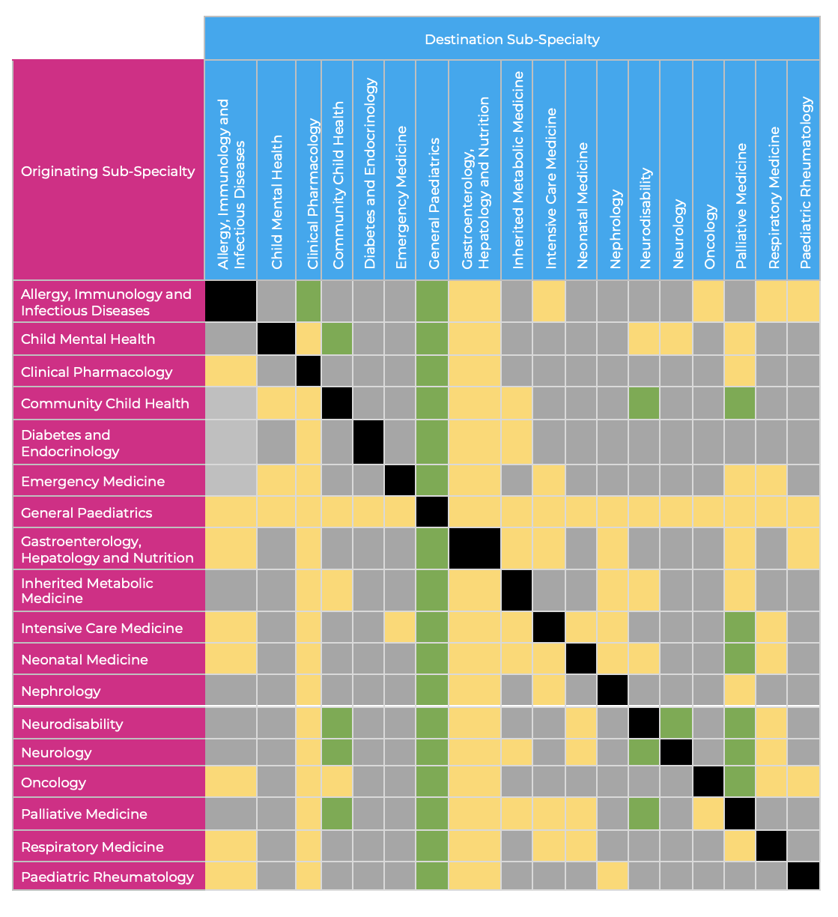
Notes:
Green: many shared capabilities, application to move between training pathways is likely to be possible.
Amber: some shared capabilities, application to move between training pathways may be possible
Grey: few shared capabilities, application to move between pathways is unlikely to be possible.

Slide 9
Progress+ Transition planning
Progress+ Transition planning
Existing pathway
ST1 | ST2 | ST3 |  | ST4 | ST5 |  | ST6 | ST7 | ST8
*
ST1 | ST2 | ST3 | ST4 |  | Old ST5 posts |  | Specialty Training
Progress+ pathway
*
Trainee flexibility; to remain in Core or progress to Specialty
Notes:
Showing what will happen to trainees in August/September 2023 at the point of transition. Those finishing ST4 will have a choice to move into Specialty training or to remain in core. This and the following slides refer to Full time trainees who have no statutory leave or OOP

Slide 10
Trainees finishing ST1 in Summer 2023
Move into Core Training as ST2
Indicative CCT date 2029
Should pass all written parts of MRCPCH by end ST3
Should pass full clinical by end ST4
Transition to middle grade working during ST3

Slide 11
Trainees finishing ST2 in Summer 2023
Move into Core Training as ST3
Indicative CCT date 2028
Should pass all written parts of MRCPCH by end ST3
Should pass full clinical by end ST4
Transition to middle grade working during ST3

Slide 12
Trainees finishing ST3 in Summer 2023
Move into Core Training as ST4
Indicative CCT date 2027
Should have passed all written parts of MRCPCH by end ST3
Should pass full clinical by end ST4
Will be on middle grade rota in ST4
Look for opportunities for supported middle grade experience in ST3

Slide 13
Trainees finishing ST4 in Summer 2023
Must have passed MRCPCH clinical by end ST4 (Summer 2023)
Will already have been on middle grade rota for a year
THESE TRAINEES HAVE A CHOICE OF PATH AND THEREFORE EARLY DISCUSSION WITH SUPERVISORS/TPDs IS ESSENTIAL
Notes:
This is the most complex group and early discussion with supervisors and TPDs is essential. Whether a trainee continues to Specialty training or stays in core training, they should have passed their MRCPCH clinical by the end of ‘old’ ST4

Slide 14
Trainees finishing ST4 in Summer 2023
Either:
Remain in core training
Indicative CCT date 2027
Move into specialty training in August/September 2024
Or:
Move straight to Specialty Training
General Paediatrics
or
Sub-specialty training (applying in 2022/23 application round)
Indicative CCT date 2026
Notes:
Whether a trainee stays in Core Training or moves up to Specialty Training, they can do so on a standard ARCP outcome 1 (as long as trainees have passed MRCPCH clinical and there are no other training concerns).

Slide 15
Trainees finishing ST4 in Summer 2023
Why Remain in Core Training?
For additional experience before Specialty Training
To increase preparation and application opportunities for Sub-Specialty Training
If level 2 capabilities have not been fully met
Why move straight into Specialty Training?
Completed all Level 2 capabilities
Ready to progress
Appointed to sub-specialty training in 2022/23 recruitment
NB – outcomes of sub-specialty applications for 2022/23 will be released BEFORE these trainees have to formally decide if they want to remain in Core or move into Specialty Training
Notes:
The decision to remain in Core or move to Specialty Training will depend on trainee choice and capability after discussion between trainers and trainee. If a trainee wants to move from ST4 to sub-specialty training in August/September 2023, they will apply for their chosen sub-specialty in the 2022/23 recruitment round. They will need to be on track to complete all Level 2 capabilities by the start of Sub-specialty training. This does not depend on specific placements but there will need to be early discussion and planning to ensure that placements are suitable to enable the trainee to meet the L2 capabilities.

Slide 16
Trainees finishing ST5 in Summer 2023
Move into Specialty Training
General Paediatrics
or
Sub-specialty training (therefore applying in 2022)
Indicative CCT date 2026
May be able to apply to move between Sub-Specialty/General Paediatric training during the first year in Specialty Training.
Notes:
These trainees will also be applying for sub-specialty training in 2022/23 recruitment round.

Slide 17
Trainees finishing ST6 in Summer 2023
Continue training as Specialist Trainee in
General Paediatrics
or
Sub-specialty training
Indicative CCT date 2025

Slide 18
Trainees finishing ST7 in Summer 2023
Continue training in
General Paediatrics
or
Sub-specialty training
Indicative CCT date 2024
Trainees who are in or starting ST8 in 2023 have the option of remaining on Progress until 15th September 2024
Trainees finishing ST8 in Summer 2023
Will CCT before implementation of Progress+

Slide 19
ARCPs
Summer 2023
The ARCP will be judged against the Progress Level 1,2 and 3 curricula
Consider ST4 who wish to complete L2 training
No requirement for time based specific placements
Range of SLEs across general, neonatal and community settings
After Summer 2023
ARCPs will be judged against Progress+ Core and Specialty Curricula
ST8 can remain on L3 Progress until 29/9/2024
‘light touch’ ARCP for ST4 completing core in 2024
Significant overlap between learning outcomes in Progress vs Progress+
Notes:
Nb: completion of the level 2 curriculum no longer depends on specific time based placements (eg 6m community or neonatal posts) but asks for a range of SLEs across neonatal, general paediatric and community settings: needs advanced planning re L2 training posts and flexibility at ARCP if hoping to sign off L2 after ST4.
Be aware that trainees coming to the end of ST4 core in 2024 may have already been signed off for ’old’ Level 1 and discretion should be used in judgements
Trainees should be reassured that the Progress+ Core Curriculum is based largely on the Progress level 1 and 2 curriculum with a change in emphasis (especially around mental health and public health) and less reliance on specific placements rather than significant new content. L3 and specialty generic LOs very similar. Subspecialty, no real change

Slide 20
ARCPs
The new curricula are already available on the RCPCH website
Progress+ curriculum is a change of emphasis rather than significant new content
Trainees can start to include evidence of learning around child mental health, public health and in a variety of settings before 2023.
None of the learning acquired to date will be lost and all capabilities will be carried over and mapped to Progress+

Slide 21
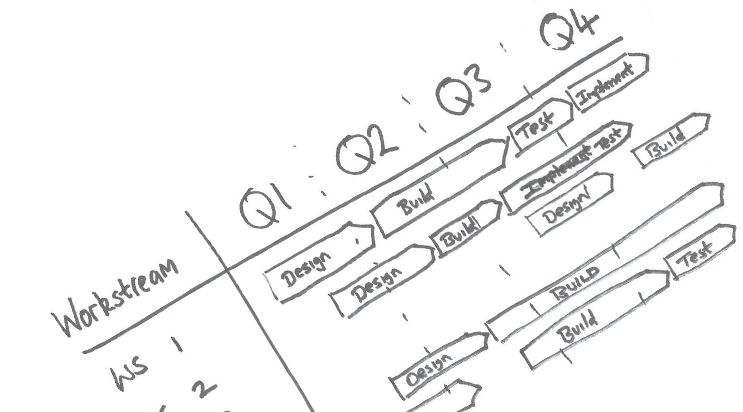
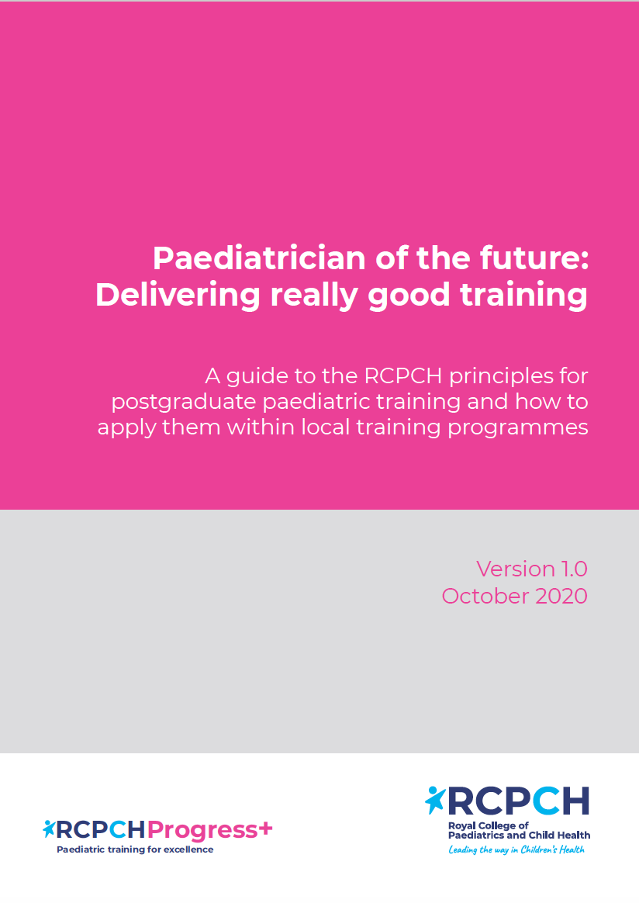
Paediatrician of the Future: Delivering really good training
Describes the principles of an excellent training programme.
Training Principles
Every patient encounter is a learning opportunity
Complex case management provides rich learning opportunities
Clinical reasoning skills are explicitly taught
Patients and families are heard
A biopsychosocial approach is applied at all times
Leadership skills are developed and nurtured
Learning opportunities are prioritised within workplace
Educational supervision is high quality and consistent
Morale and job satisfaction are improved
Assessment is used as a learning tool
Progression and length of training are personalised
…less concerned with the what and where
… more concerned with the how….
Notes:
This document is designed to be used alongside Progress+ to make sure that training and learning is broad and that all generic capabilities are met. The curriculum does not just concentrate on acute clinical paediatrics but ensures that capabilities across child mental health, public health are achieved. The aim is to train doctors who can practice holistically and across a wide range of settings. Making sure that trainees get really good training will depend on supervisors being familiar with the curriculum and these principles.

Slide 22
Next steps: Trainees
This is particularly important for current Level 1 trainees:
Discuss your training over the next 2 years with your ES
Become familiar with Progress+ curriculum
Look for learning in child mental health and public health, take opportunities in a range of settings.
Think about future career plans: consider Sub-specialty placements or taster experience.
If wanting to enter subspecialty training in 2023 (will be ST4 or ST5 in 2022/23) start considering your sub-specialty application which will need to be submitted towards the end of 2022.
If you will be ST4 in 2022/23 discuss with your ES/TPD now what your training pathway will be
Notes:
Trainees can be proactive in looking for opportunities within child mental health and public health, which have a greater emphasis in the Progress+ curriculum. For example:
A trainee sitting in with the CAMHS team who come to assess a young person presenting to paediatric ED with suicidal ideation.
A trainee discussing vaccinations with vaccine hesitant parents on a general paediatric ward round
A trainee notifying public health England after a paediatric patient presenting with a notifiable disease

Slide 23
Next steps: College Tutors
Plan and deliver local events to educate trainees and supervisors
Identify local Progress+ champions (trainees and trainers)
Identify trainees locally who will be finishing ST4 in summer 2023 and ensure they have early discussions with their Educational Supervisors about their plans for transition.
Promote ‘Paediatrician of the Future’ document
Promote ‘Principle of the Month’
Encourage and enable trainees to develop middle grade capabilities during ST3
Develop local teaching from and with related specialties (CAMHS, Public Health, primary care)
Notes:
Principle of the month – looks at one of the training principles from “Paediatrician of the Future” each month, and provides ideas of how this can be achieved and resources for College Tutors to use. On the RCPCH website every month and in the bulletin and on social media.
The RCPCH Training and Assessment team are very happy to support college tutors or schools with resources, planning and delivery of local events and can be contacted at progress-plus@rcpch.ac.uk
(see final slide)

Slide 24
Next steps: Schools
Plan local events to educate college tutors, trainees and supervisors
Review supervision models and move towards longitudinal supervision where possible.
Review placements
Work with units and subspecialties to provide Specialty taster experiences
TPDs should have one:one meetings with all trainees who will be ST4 in the 2022/23 training year to plan individualised transition plan
Consider implications for LTFT trainees or those who are OOP or on Statutory leave
Review regional teaching programme to align with Progress+
Notes:
Trainees could use study leave or SPA time to create taster experiences over a few days or a week. Alternatively sub specialty experience can be built into training with attendance at specialty clinics or specific placements.
We strongly suggest that longitudinal educational supervision will enhance use of Progress+ and the embedding of capability progression. This may be across a level of training rather than the whole programme.

Slide 25
Progress+ will be implemented in August/September 2023
2023

Slide 26
Progress+ Curriculum
For more details..
Check out our information packed landing page on the RCPCH website, devoted to updates and announcements about the move to Progress+.
Just type in ‘Progress+’ in the search box on the website to find out more!
For questions and advice email: progress-plus@rcpch.ac.uk
RCPCH Training and Assessment team are very happy to support college tutors or schools with resources, planning or delivery of local events.

Slide 27
Any questions?

